Slide 2
We’re engaged! Strategies for enhancing community-researcher relationships
Ntando Yola
@ntandoy / @apha_sa
Share your thoughts on this presentation with #IAS2019

Slide 3
Conversations and interactions amongst peers
Literature in CE
Hearing from communities
Experiences in doing CE

Slide 4
Layout
What Community Engagement (CE) in research is?
What CE is not?
Who are communities and their characteristics?
HIV research in the radar of communities’ lives
Hearing and understanding communities better
Sustaining & evaluating engagement
What’s my point?

Slide 5
What Community Engagement in research is?
It is a science
Should be approached as development
To improve research conduct and its outcomes
Ensures community input into the design and implementation of studies and development
Should not be means to an end
Continuous, sustained and resourced
Seeks to align research with communities’ context
Remain relevant to their development and future needs

Slide 6
‘Community engagement’ …is the meaningful, respectful, and fit-for-purpose involvement of community members in one or more aspects of ‘research’, and may include involvement during the identification of the study, to defining its purpose and design, to stages of implementation, interpretation, and use of results.
Glandon, D., et al (2017)

Slide 7
What CE is not?
Conducting meetings
At the beginning, during and disseminating results
Community Advisory Boards in isolation
Free and automated process
Recruitment into research studies
Most exciting endeavor for communities
Viewed without suspicion

Slide 8
”There can be no shortcuts in research and prevention… We have to involve almost everyone”
Vuyiseka Dubula-Majola

Slide 9
Who are communities and their characteristics?
They vary from one geographical area to another
They are complex and fluid in nature
Even if they are in Africa they are not the same
“Women in sub-Saharan countries are considered to be one of the most vulnerable populations in the world for HIV”
They are resilient in their yearn for livelihood
Their hardships are not an ultimate identity
Are protective of their surroundings and various forms of resources
Evolving and dynamic

Slide 10
To understand some of the complexities, complications, and confusions within the life of just one member of a community is to gain insights into the collective’.
Coles and Knowles (2001: 11)

Slide 11
HIV research in the radar of communities’ lives?
There is a lot known about HIV and what ought to be done
At individual and community levels
Knowledge doesn’t automatically translate to understanding or perception
Risk perception
Until HIV becomes reality
HIV prevention (research) is not a daily ’to do list’
Sustained engagement works with communities as a reminder on efforts of a collective

Slide 12
“I don’t wake up everyday thinking how am I going to doge HIV and being violated as a young woman”
Ntokozo Zakwe – 2019 AVAC Fellow

Slide 13
Hearing and understanding communities better
Investment in developing the body of knowledge in CE
Implement Community-Based Participatory Research approaches
View communities as less of subjects to be studied
Recognize and build on the social and physical capital communities have
Allow self mobilization and organizing for change
Be conscious on how we representing the other

Slide 14
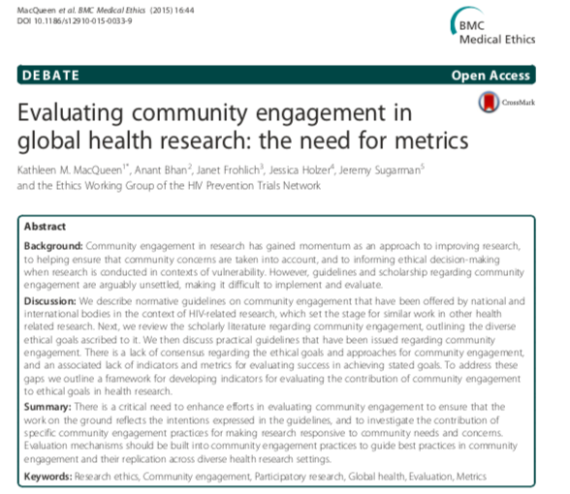
Sustaining & Evaluating engagement in research
Community engagement relies heavily on partnership and mutual reciprocity between different stakeholders such as communities, universities, non-government organizations, field experts and funding organizations.
Nur Naha Abu Mansor, 2014
There is a critical need to enhance work in evaluating community engagement—to ensure that the work on the ground reflects the intentions expressed in the guide- lines, and also to investigate the contribution of specific community engagement practices for making research responsive to community needs and concerns.

Slide 15
What’s my point?
The five characteristics of engagement are:
community involvement in assessment;
access to information;
inclusion in decision making;
local capacity to advocate to institutions and governing structures; and
accountability of institutions to the public.
Funding and resourcing all round community engagement in research

Slide 16
Thank you!
African HIV Prevention Research Communities and Advocates in the Diaspora

